Slide 1
Game Pitch
Programming is Pain

Slide 2
Ideas
Simple point controlled game that relies on finger touch to look around and shoot arrows at targets. These targets get destroyed once hit, new ones spawn randomly. The targets will range in difficulty, for example ones a lot father away/hidden behind something and ones that appear right in front of you. This is all done in a set timer, get a certain amount of points per target destroyed you get more time to continue.
Side scrolling platformer. To complete a level you must retrieve the pickup or “gift”. Player has the regular wasd, jump and crouch controls. Turret continuously shoots projectiles at player while they must avoid passive enemies. The level consists of simple platforms and enemies. Player takes a certain amount of damage every time they’re hit by the turret, dies if the are killed by passive enemy.

Slide 3
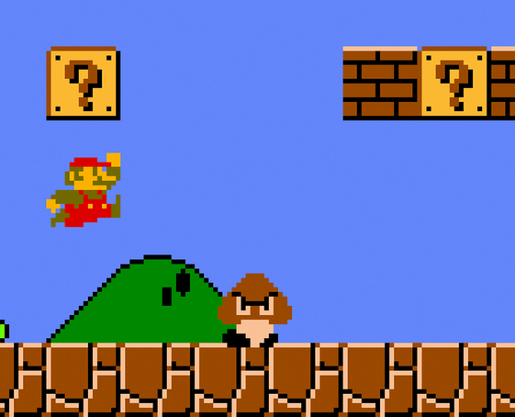
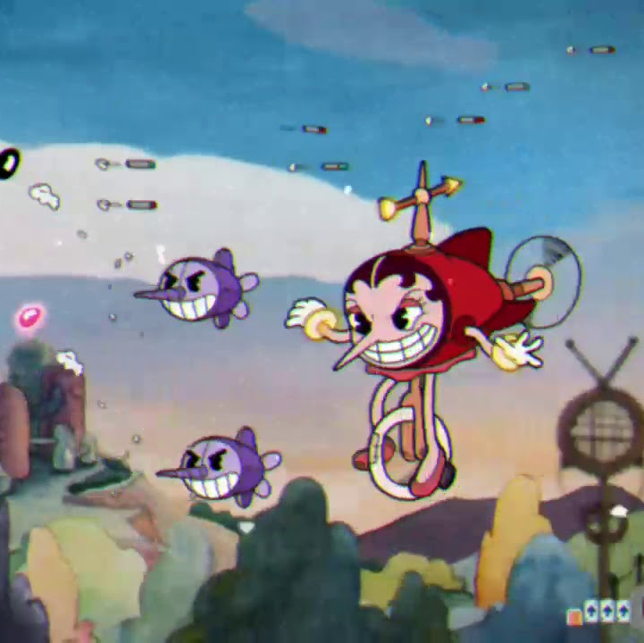

Inspiration
Super Mario
2D pixel stylized side scroller
Using simple platforms to overcome obstacles
CupHead
2d side scrollers
Big boss who shoots projectiles
Player must swerve constantly to avoid being hit by stray enemies and projectiles.

Slide 4
Weekly Deadlines
Week 1
Character control/moveability(wasd, jump and crouch) DONE!
art assets from unity store & start on game environment DONE!
Week 2
Death Zone Done!
Player health & spawn Done!
Week 3
Place the pickup “key” that unlocks level doors, place level doors.
Set animations for key, doors and platforms.
Passive enemy spawns & placement (are they still or moving)??? Maybe not???
Week 4
Figure out how to spawn projectiles from a specific entity
Make cannon track player shooting projectiles, when projectile hits, player is transported back to spawn

Slide 5








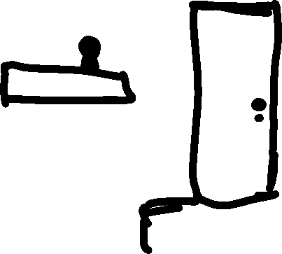
















Slide 6
Tutorials and asset packs used so far
Asset Packs
Sunny Land – Ansimuz
Free 2D Platform Game Assets – Bayat Games
Scripts
Advanced character controller – Brackeys https://github.com/Brackeys/2D-Character-Controller (Need to check if we can actually use this with Brendan, if not create own 2d character controller script)
https://www.codemahal.com/video/adding-a-delay-to-respawn-in-a-2d-unity-game/ (Used part of code for the Coroutine function to delay the transform.position
Tutorials
2D Movement in Unity (Tutorial) – Brackeys https://www.youtube.com/watch?v=dwcT-Dch0bA (Showed us how to reference controller script to make the character actually move on horizontal axis, jump and crouch. Also smooth colliders on player and slippery material)
2D Animation in Unity (Turtorial) – Brackeys https://www.youtube.com/watch?v=hkaysu1Z-N8&list=PLPV2KyIb3jR6TFcFuzI2bB7TMNIIBpKMQ&index=3 (Showed us how to make animation clips and assign them in the animator, then how to assign the animator in the script.

Slide 7
Things to fix later
Y I K E S
Whenever the Player runs quickly and hits a platform the box collider on the player is removed much like it is when crouched. This may be because of the slippery material added to player’s collider box?
Look at smart turret AI in asset store.
The GameManager script moves its position every time the player respawns for whatever reason. It was originally on the camera which made us unable to see the whole scene so we kinda fixed it by placing the script as an empty object.

